Slide 1

PROJECT REPORT on IOT Analytics Using Predictive Models And Integration With Edge Devices To Send Commands Based On Prediction Outcomes. Submitted in partial fulfillment of requirements for the award of Submitted by: Twinkle Dey-(ET16BTHEC046) Ritpan Changmai-(ET16BTHCS033) Bornali Neog-(ET16BTHCS040) Trinayan Borah-(ET16BTHCS033) Under the Supervision and Guidance of Yogendra Solanki Manashee Kalita

Slide 2
INTRODUCTION
IOT
Internet of Things - Anything that has a sensor attached to it and can transmit data from one object to another or to people with the help of internet
a Predictive model that predicts a faulty condition ahead of time.
Internet of Things (IoT) have evolved tremendously in all spheres of our lives like Industrial applications, Social interactions, Remote management of facilities and equipment to name a few.
IoT has easied the lives of humans. Imagine a hospital connected with all the smart devices.

Slide 3
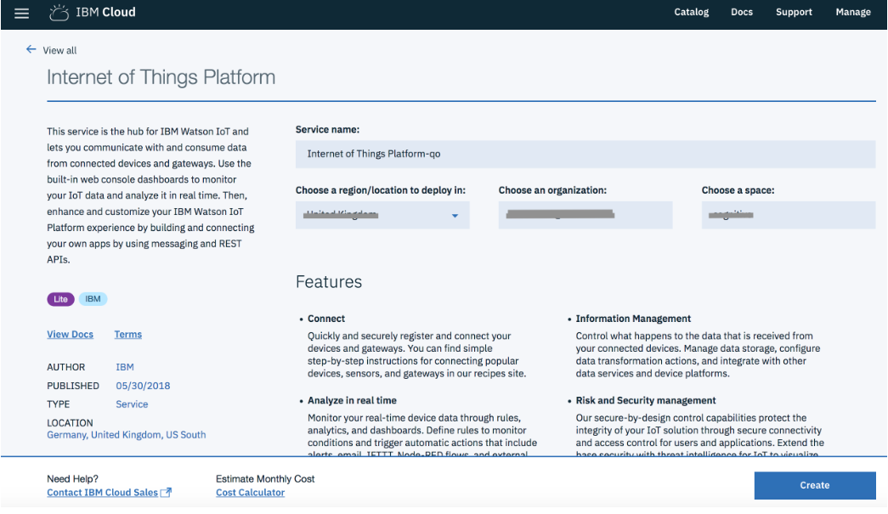
Ibm Iot Platform:

Slide 4
SERVICE DETAILS
IBM Cloud
IBM's innovative cloud computing platform or IBM Cloud combines.
Platform as a service (PaaS) with infrastructure as a service (IaaS).
IBM Watson IoT Platform
IBM Watson IoT Platform for IBM Cloud gives you a versatile toolkit that includes gateway devices, device management, and powerful application access.
By using Watson IoT Platform, you can collect connected device data and perform analytics on real-time data from your organization.
IBM Watson Studio
Analyze data using Python, Jupyter Notebook and RStudio in a configured, collaborative environment that includes IBM value-adds, such as managed Spark.
DB2 Warehouse
IBM Db2 Warehouse on Cloud is a fully-managed, enterprise-class, cloud data warehouse service.

Slide 5
The end to end process steps for applying Analytics on IoT data are listed below:
Collect IoT data from sensor
Change point detection using IoT Sensor data.
Predicting equipment failure using IoT Sensor data.
Sending decisions based on Analytics insights to the edge for automated action.

Slide 6
Steps of the process:
Send events from an edge device (we use Raspberry Pi for demonstration) to the Watson IoT Platform
Store the events in a DB2 database on IBM Cloud
Invoke a predictive model on Watson Studio for IoT events using the below code patterns:
Predict equipment failure using IoT sensor data
Orchestrate data science workflows using Node-RED
Send a command back to the edge (we use Raspberry Pi for demonstration) based on the outcome of the predictive model

Slide 7
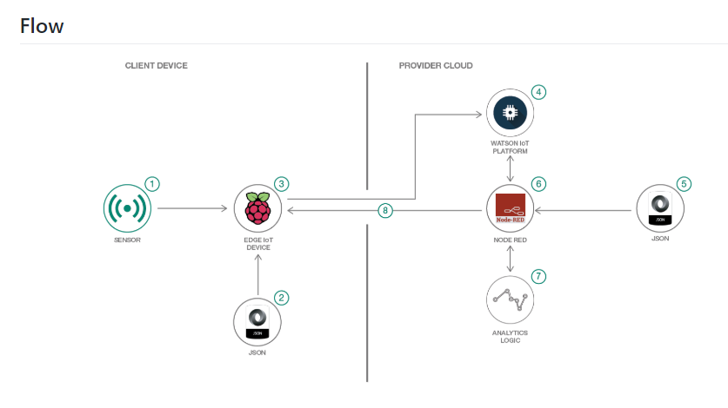
Flow diagram:

Slide 8
Steps to proceed:
The Raspberry Pi gets events from the sensors. In the absence of sensors, the sensor events are read from a file.
The Node-RED flows are invoked on the Raspberry Pi.
The sensor events are sent to the Watson IoT platform.
The Watson IoT platform receives the events and sends it to all subscribing applications.
The Node-RED flows on IBM Cloud are triggered. The sensor events are recieved and stored into a database.
The predictive model on Watson Studio is triggered. The outcome of the model execution is sent back to the Node-RED through websockets.
Based on the outcome, the Node-RED flow sends a command with the action to be taken to the edge device(Raspberry Pi) through the Watson IoT platform
The Node-RED flow on Raspberry Pi recieve the command

Slide 9
Data import:
Implementing device client on Raspberry Pi to send events to Watson IoT platform
Consuming events from Watson IoT platform on IBM Cloud and storing the events in a DB2 database
Invoke predictive model on Watson Studio and get a response back for an IoT event
Send a command back to the Raspberry Pi through the Watson IoT platform

Slide 10
Explanation:
This data is sent to the Watson IoT platform and stored in a DB2 database
A predictive model is built using the data in the DB2 database
The predictive model then takes the sensor events from Watson IoT platform as input and returns the state of the equipment as running or falling.
If the equipment is failing, then a shutdown command is sent back to the edge device which is a Raspberry Pi.

Slide 11
Node-red
Node-RED is a programming tool for wiring together hardware devices, APIs and online services in new and interesting ways.
Browser-based flow editing:
It provides a browser-based editor that makes it easy to wire together flows using the wide range of nodes in the palette that can be deployed to its runtime in a single-click.
Social Development:
The flows created in Node-RED are stored using JSON which can be easily imported and exported for sharing with others.

Slide 12
JSON
JSON: JavaScript Object Notation is an open-standard file format that uses human-readable text to transmit data objects consisting of attribute–value pairs and array data types (or any other serializable value).
It is a very common data format, with a diverse range of applications, such as serving as replacement for XML in AJAX systems. It was derived from JavaScript.

Slide 13
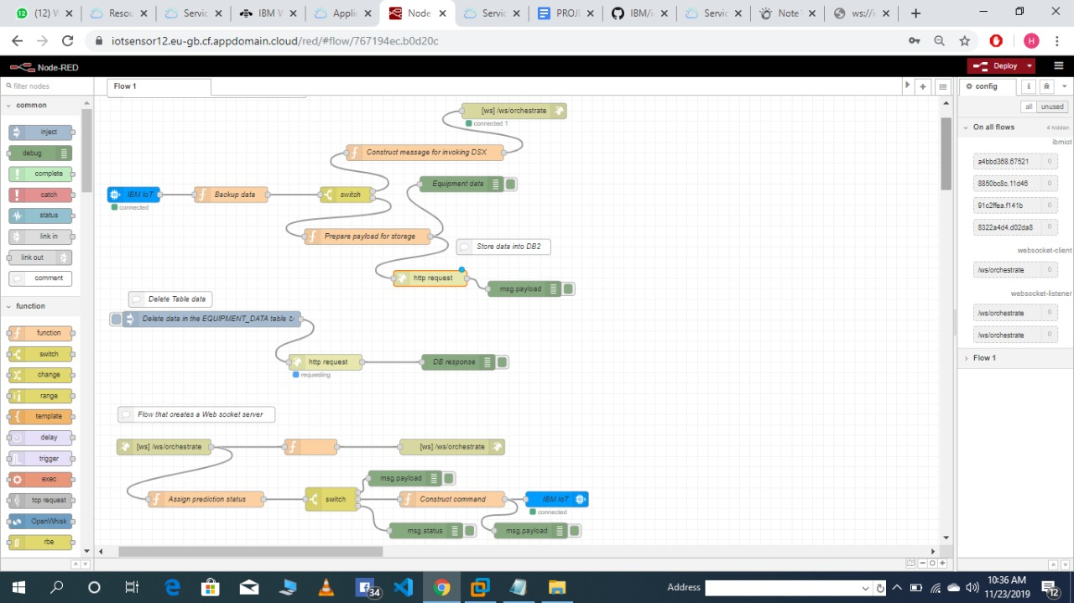
FLOW DIAGRAM OF NODE-RED

Slide 14
THANK YOU

